Slide 1
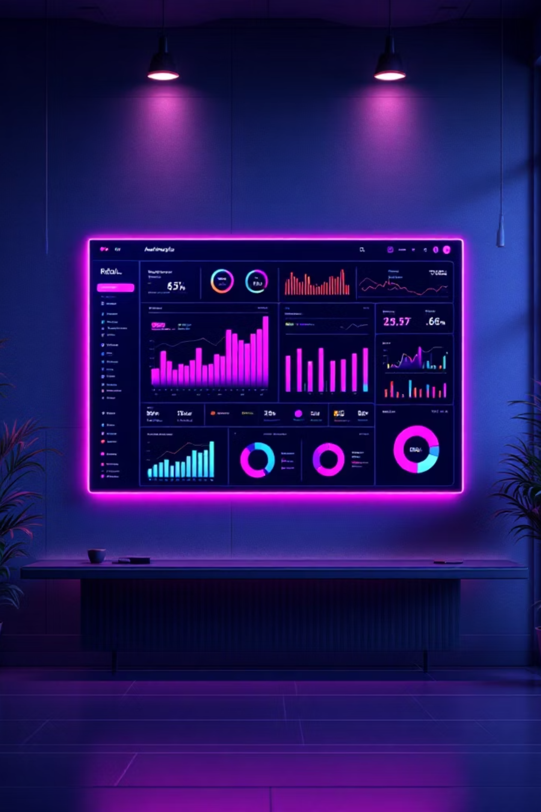
Customer Shopping Behavior Analysis
Uncovering insights from 3,900 transactions to guide strategic business decisions

Slide 2
Dataset Overview
3,900
18
37
Transactions
Features
Missing Values
Purchase records analyzed
Data points per transaction
Review ratings imputed
Dataset includes customer demographics, purchase details, and shopping behavior metrics.

Slide 3

Python Data Preparation
Data Cleaning
Feature Engineering
Imported with pandas
Checked structure and statistics
Imputed missing review ratings
Standardized column names
Created age groups
Calculated purchase frequency
Dropped redundant promo codes
Loaded to PostgreSQL

Slide 4
SQL Analysis: Revenue Insights
Gender Performance
Age Groups
Shipping Impact
Male customers generated $157,890 vs. female customers at $75,191
Young adults led with $62,143, followed by middle-aged ($59,197), adults ($55,978), and seniors ($55,763)
Express shipping averaged $60.48 vs. standard at $58.46

Slide 5


Product Performance
1
2
Top-Rated Products
Discount-Heavy Products
Gloves (3.86), Sandals (3.84), Boots (3.82), Hat (3.80), Skirt (3.78)
Hat (50%), Sneakers (49.66%), Coat (49.07%), Sweater (48.17%), Pants (47.37%)
3
Category Leaders
Blouse, Pants, Jewelry, Sunglasses, Sandals, Shoes, Jacket, Coat

Slide 6

Subscription Analysis
Subscriber vs. Non-Subscriber
2,847 non-subscribers spent $170,436 (avg: $59.87) vs. 1,053 subscribers spending $62,645 (avg: $59.49)
Repeat Buyers
958 repeat buyers subscribed vs. 2,518 non-subscribers with >5 purchases

Slide 7



Customer Segmentation
79%
18%
2%
Loyal Customers
Returning
New
3,116 customers with consistent purchase history
701 customers making second purchases
83 first-time buyers

Slide 8
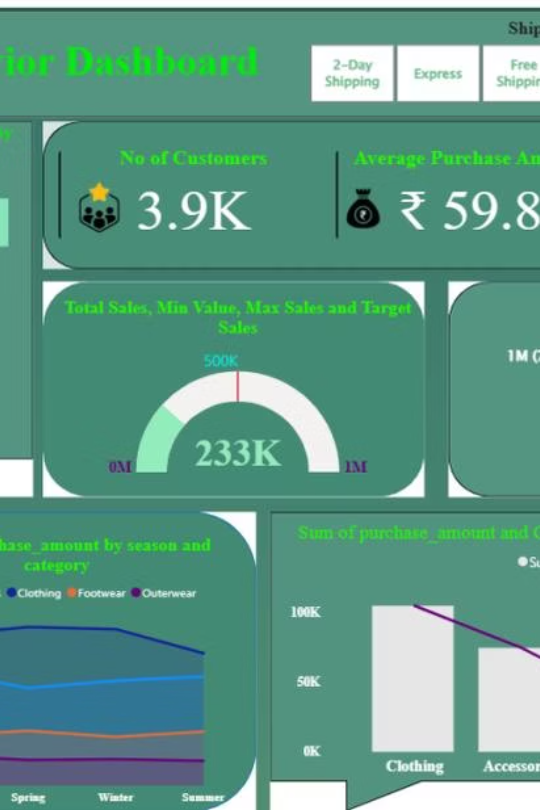
Power BI Dashboard
01
02
Interactive KPIs
Visual Filters
3.9K customers, $59.8 average purchase, 3.75 average rating
Shipping type, advice, gender, and category selections
03
Seasonal Trends
Purchase patterns across fall, spring, winter, and summer

Slide 9



Key Findings
Male Dominance
Discount Strategy
Loyalty Gap
Generated 2.1x more revenue than female customers
High-discount products drive sales but impact margins
79% loyal, but subscription conversion needs improvement

Slide 10






Strategic Recommendations
Boost Subscriptions
Promote exclusive benefits and rewards for subscribers
Loyalty Programs
Reward repeat buyers to accelerate movement into loyal segment
Review Discount Policy
Balance sales boosts with margin control and profitability
Targeted Marketing
Focus on high-revenue age groups and express-shipping users

